Slide 1
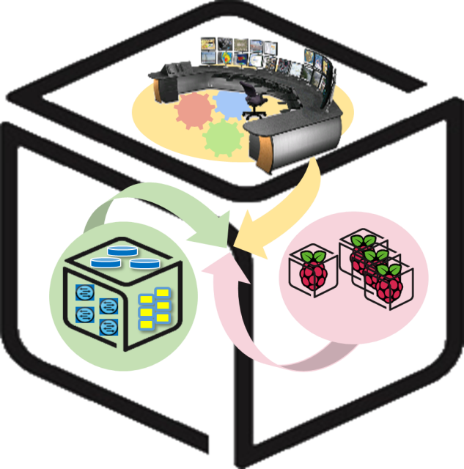



Computer Systems
For AI-inspired Cloud
Theory & Lab.
Lab #3: Tower
https://github.com/SmartX-Labs/SmartX-Mini-MOOC

Slide 2


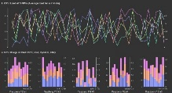





Tower Lab: Concept
Control Tower
Orchestration
Center
Provisioning
Center
Intelligence
Center
Visibility
Center
Docker Runtime
Linux Ubuntu OS

Slide 3
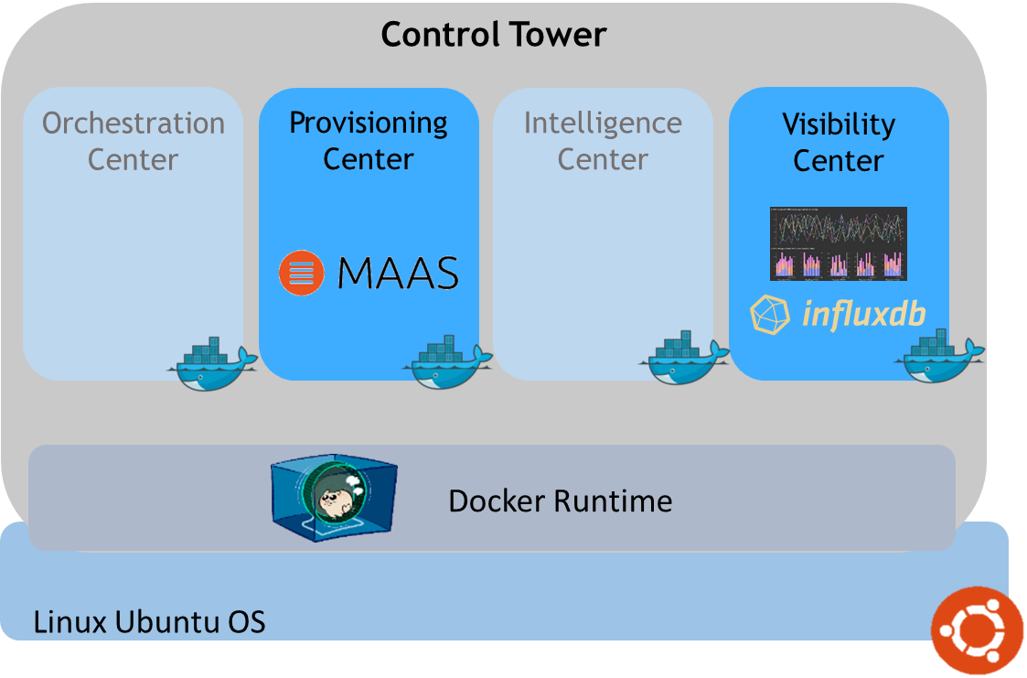


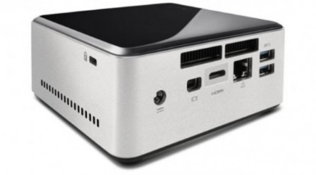



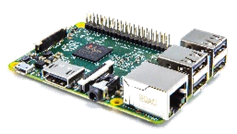



SmartX Labs #1~#3: Relationship
Tower Lab
Kafka broker cluster
Box Lab
VM
Tap1
br0
em1
Inter-Connect Lab
Hypriot OS

Slide 4



Theory

Slide 5

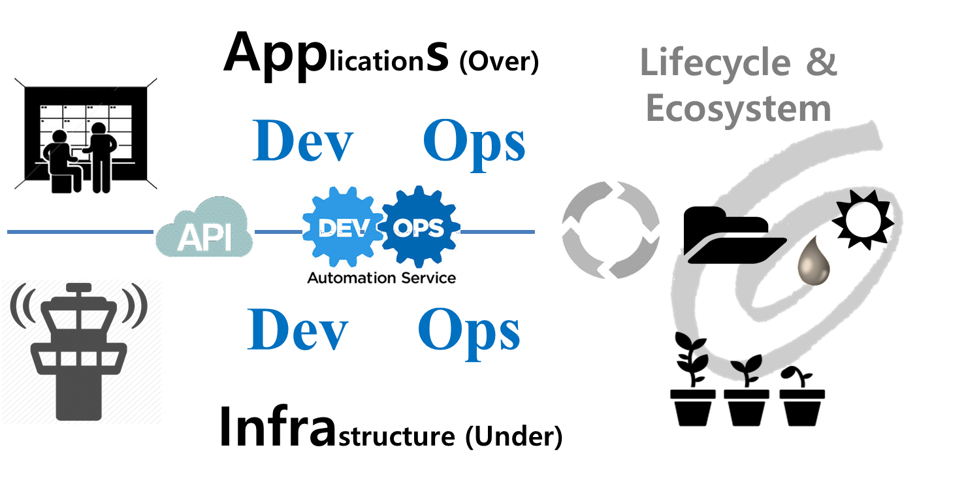
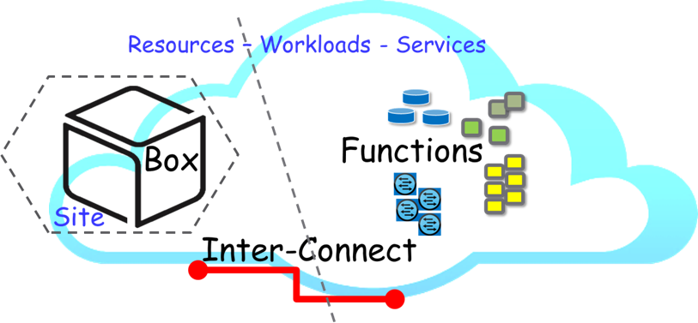
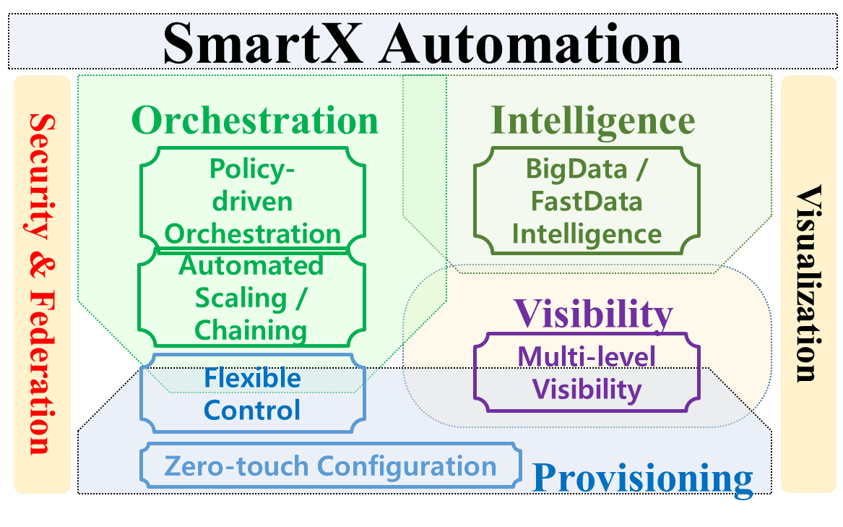
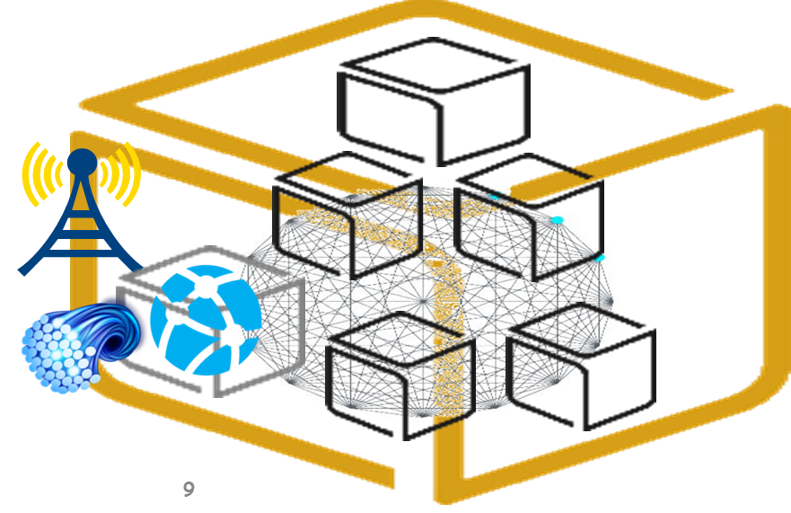
SmartX Automation Framework

Slide 6

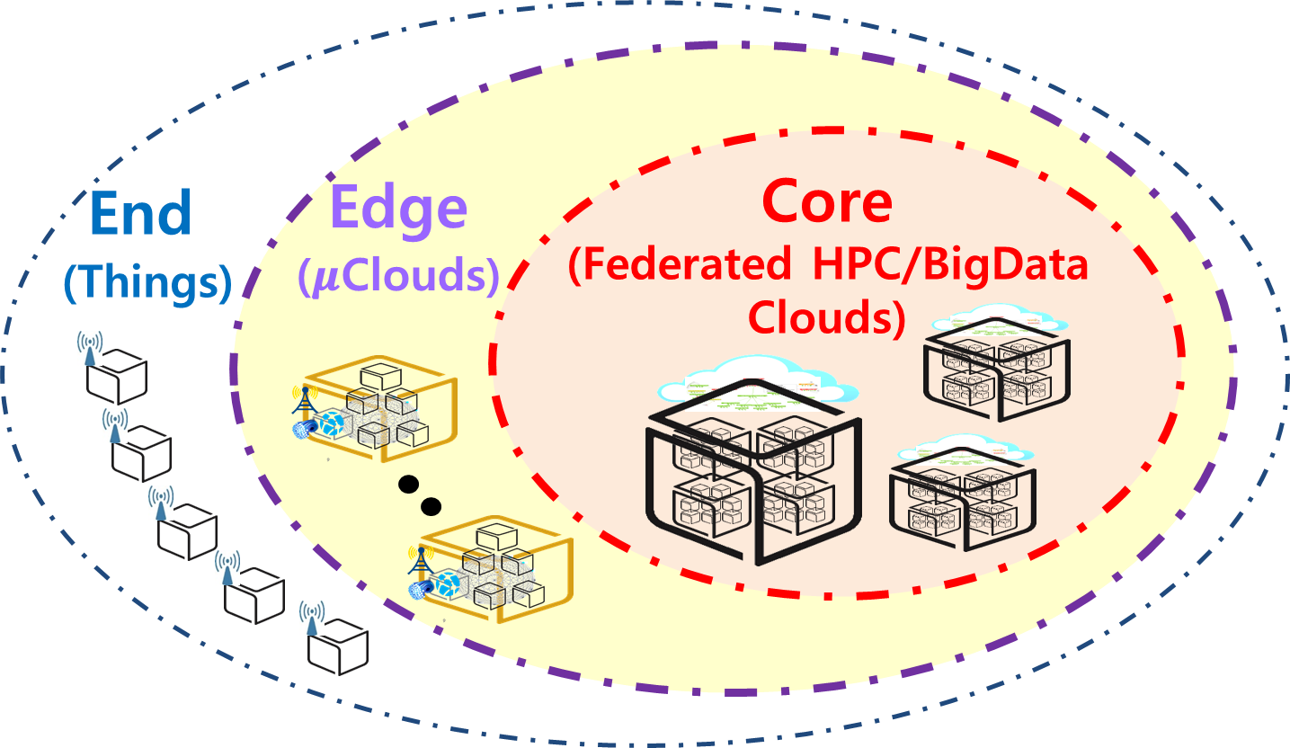







SmartX Composable Playground & Boxes
Type B/C
SmartX
Cloud Box
Type O
Type K/S
SmartX
DevOps Tower Cloud
with DataLake
SmartX
Edge μBoxes
SmartX
Edge Cluster
End
Edge
Core
Things
$μ$Clouds (SDN/NFV)
Clouds (HPC/BigData)

Slide 7
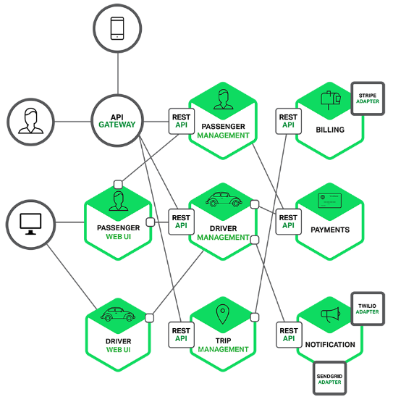
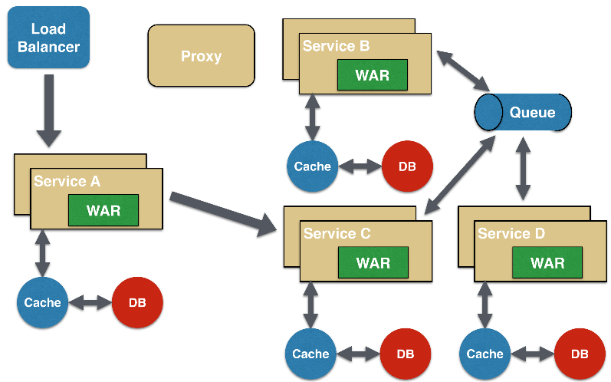
Container-based MSA (MicroServices Architecture)
Software development technique based on Collection of loosely coupled small-size services (i.e., functions)
Fine-grained services and lightweight protocols to improve modularity, create applications easier, and helps resiliency against architecture erosion

Slide 8



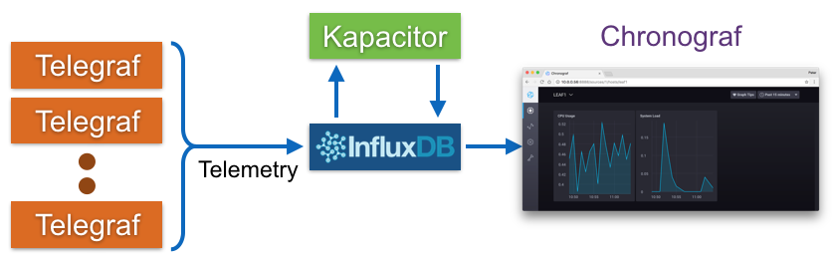
Visibility: TSDB (Time Series Database)
Time series data is arrays of numbers indexed by time.
In some fields these time series are called profiles, curves, or traces.

Slide 9

Visibility: Zabbix Distributed Monitoring
Adopts a flexible notification mechanism
User can configure & watch graph easily via Web GUI
Consists of structured server and client
Client collects the monitoring data and send it to the Zabbix server
Server visualizes the data that is collected by the Zabbix Agent
Zabbix Server Agent structure

Slide 10
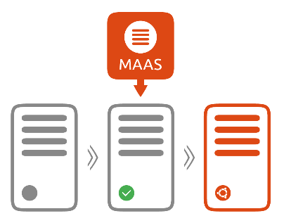
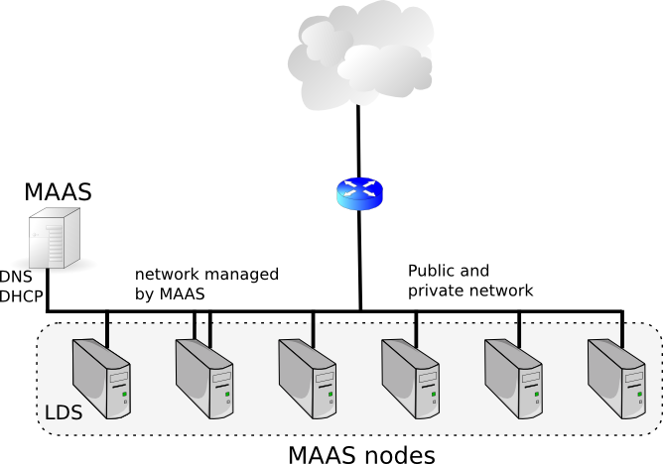
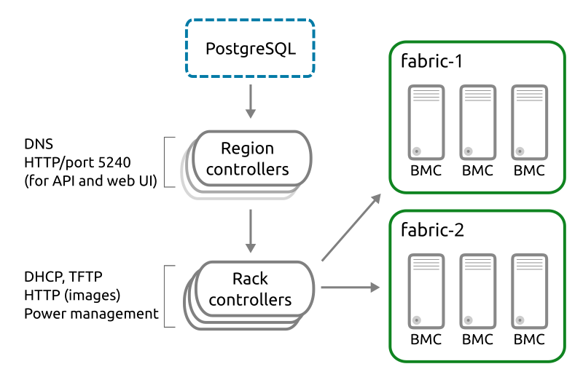
Provisioning: Ubuntu MAAS (Metal as a Service)
Bear-metal machines can be quickly provisioned and destroyed; MAAS provides management of a large number of physical machines by creating a single resource pool
MAAS can act as a standalone PXE services, provides Web GUI, supports various Linux distribution installation, …
MAAS Controller Architecture
Region Controller: Deals with operator requests
Rack Controller: Provide the high bandwidth services to multiple server racks + Cache OS install images

Slide 11
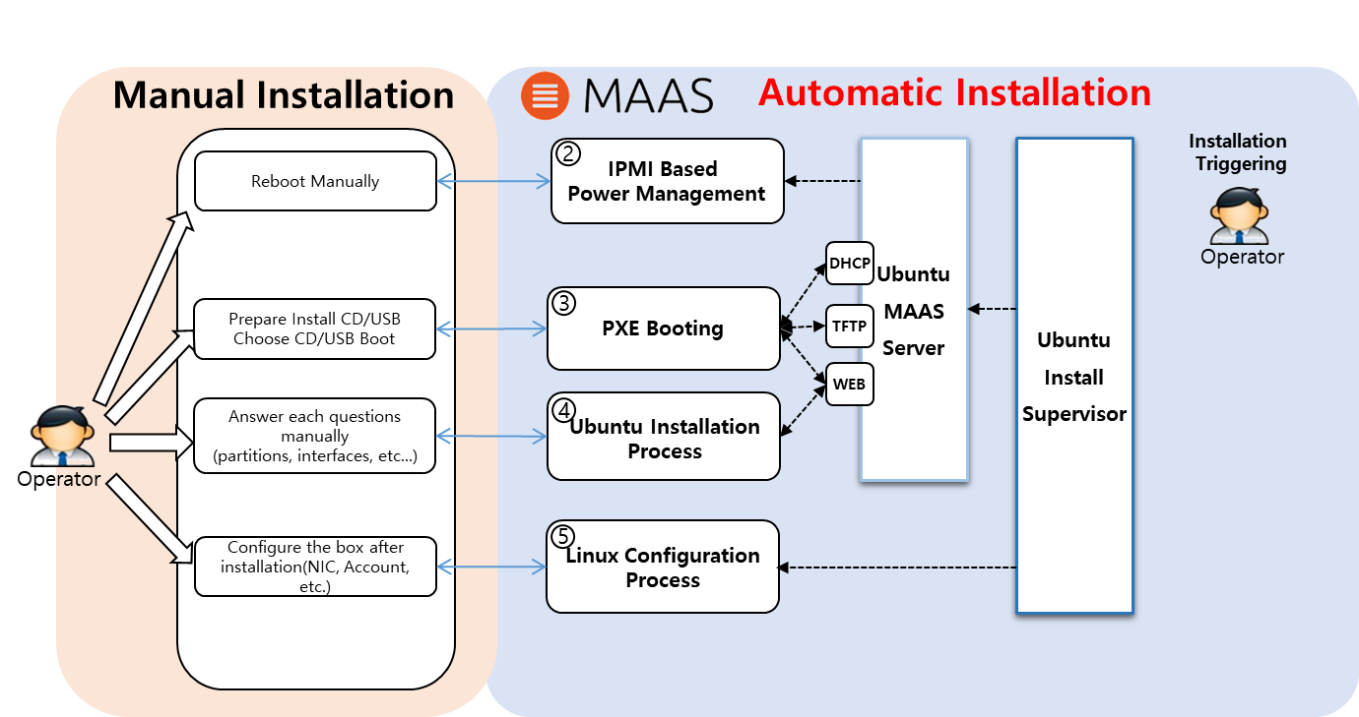
Ubuntu MAAS: Automated Installation
MAAS: Automated installation procedure
Enlistment process to register a new machine
Commissioning process to collect H/W information (CPU, RAM, Storage, etc.): All enlisted nodes must be accepted and finish this process in order to change state from ‘declared’ to ‘ready’ state
Deployment process can happen with both Ubuntu juju and/or Ubuntu MAAS (WebUI)
Box Hardware Requirements for Automated Installation
IPMI, Intel AMT, IBM HMC, …
PXE bootable with DHCP option
Two Ethernet interfaces
Warning!

Slide 12
Practice

Slide 13
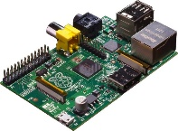
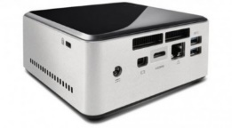


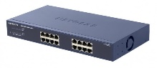
NAME: NUC5i5MYHE (NUC PC) CPU: i5-5300U @2.30GHz CORE: 4 Memory: 16GB DDR3 HDD: 94GB
#0 - Lab Preparation (1/2)
Wired connection
NAME: Raspberry Pi Model B (Pi) CPU: ARM Cortex A7 @900MHz CORE: 4 Memory: 1GB SD Card: 32GB
NAME: NT900X3A
CPU: i5-2537U @1.40GHz
CORE: 2 Memory: 4GB DDR3 HDD: 128GB
NAME: netgear prosafe 16 port gigabit switch(Switch) Network Ports: 16 auto-sensing 10/100/1000 Mbps Ethernet ports

Slide 14
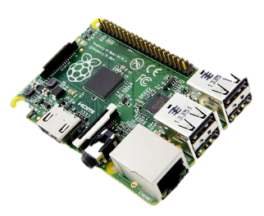








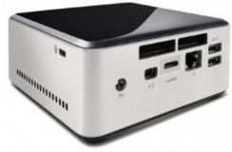
#0 - Lab Preparation (2/2)
- Verify Inter-Connect Lab’s configuration
Kafka broker cluster
Hypriot OS
Hypriot OS
Ubuntu Linux
Are they working?
If you can see logs of resource status on console consumer, go ahead!

Slide 15
Visualization of Resource Visibility
Control Tower
Orchestration
Center
Provisioning
Center
Intelligence
Center
Visibility
Center
Docker Runtime
Linux Ubuntu OS

Slide 16
#1 Run InfluxDB & Chronograf Containers on NUC
Run InfluxDB Container
$ docker run –d --name=influxdb –-net=host influxdb
Make and run Chronograf container
$ docker run -p 8888:8888 --net=host chronograf --influxdb-url=http://<NUC IP>:8086

Slide 17
#2 Install python packages:
for python Kafka consumer
Install python-pip
$ sudo apt-get install -y libcurl3 openssl curl
$ sudo apt-get install -y python2.7 python-pip
$ sudo apt-get install –y python3-pip
Install python package
$ sudo pip install requests
$ sudo pip install kafka-python
$ sudo pip install influxdb
$ sudo pip install msgpack

Slide 18
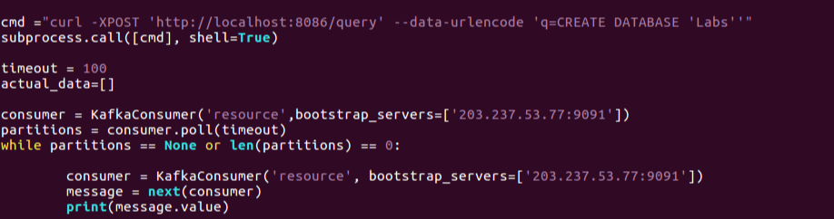
#3 Broker to InfluxDB code:
Modify & Run python code
Open ‘broker_to_influxdb.py’ code
$ vi ~/SmartX-mini/ubuntu-kafkatodb/broker_to_influxdb.py
Run python code
$ sudo sysctl –w fs.file-max=100000
$ ulimit –S –n 2048
$ python ~/SmartX-mini/ubuntu-kafkatodb/broker_to_influxdb.py
Modify to your nuc IP Address
Modify to your nuc IP Address

Slide 19
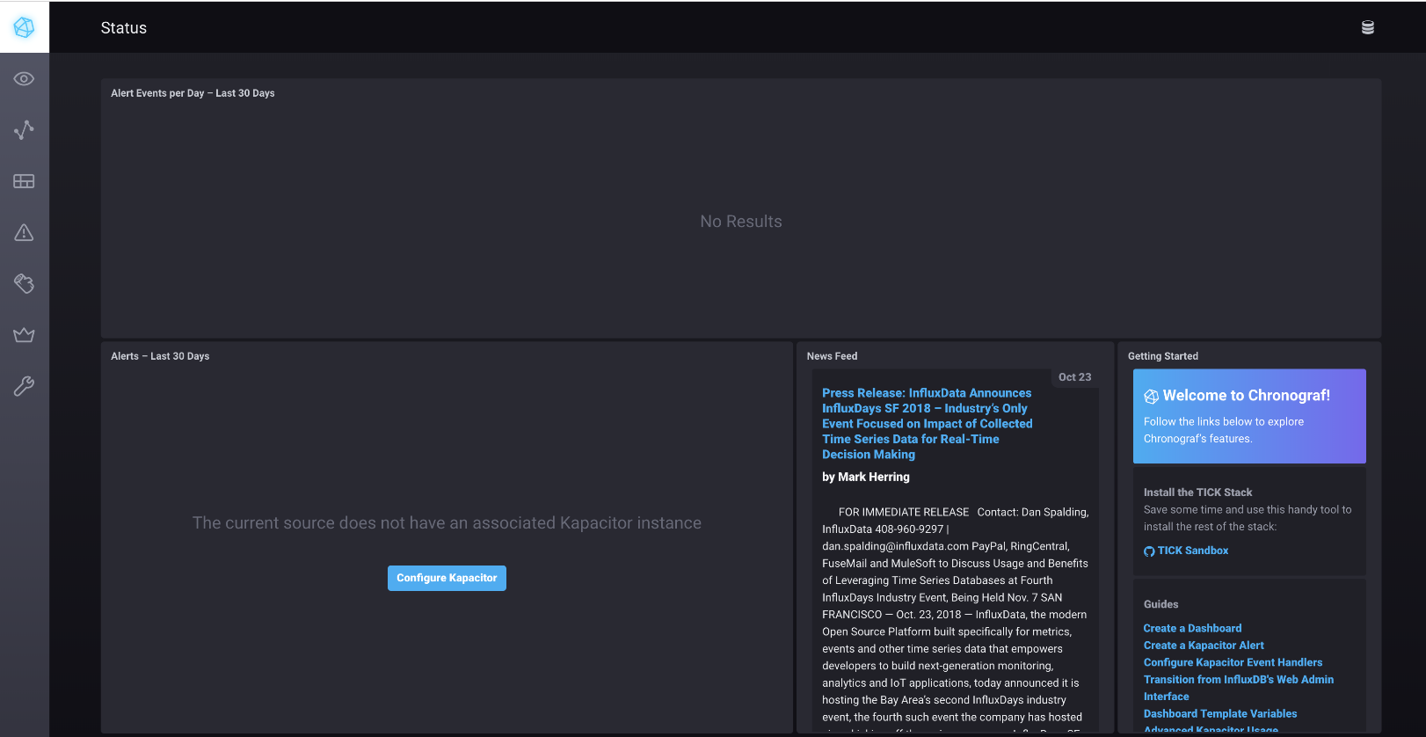
#4 Configure Chronograf Dashboard (1/4)
Open Web browser and connect to Chronograf Dashboard
http://<NUC IP>:8888

Slide 20
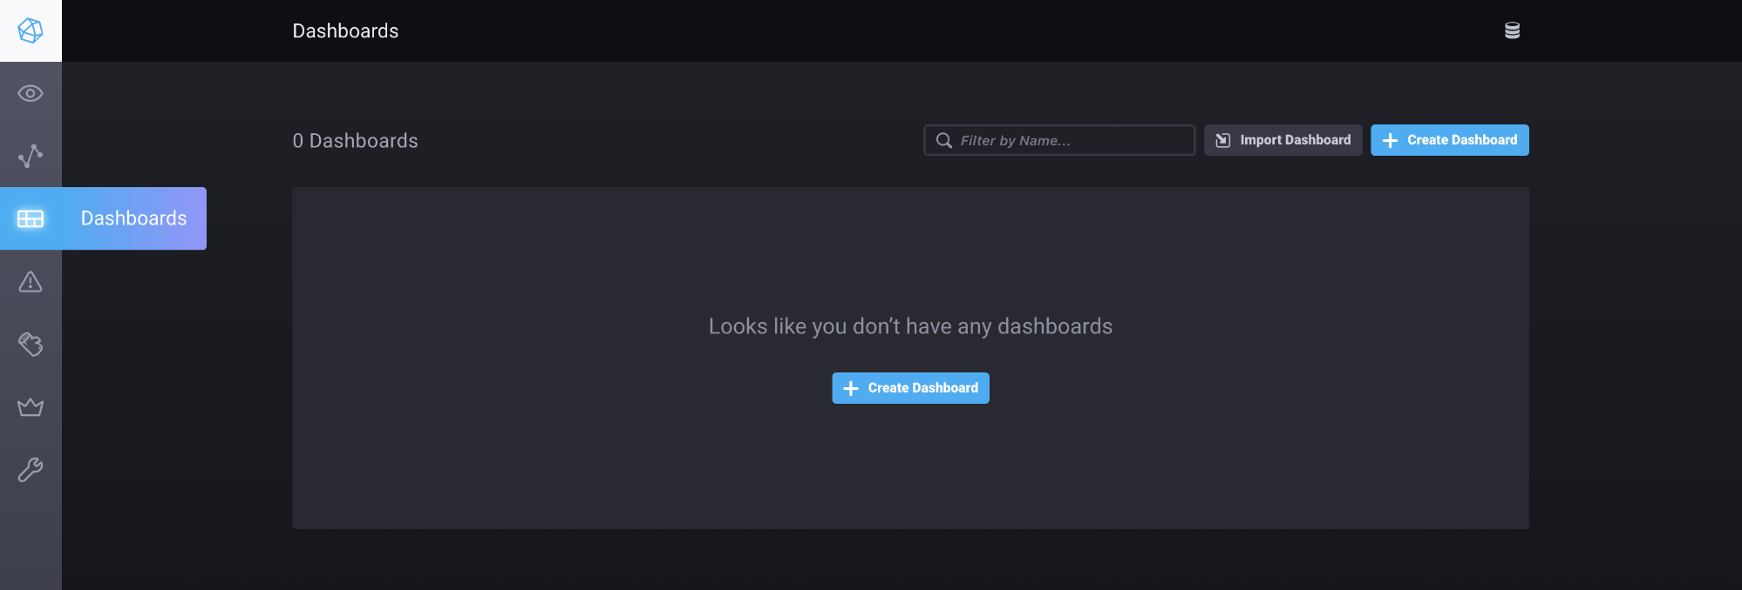
#4 Configure Chronograf Dashboard (2/4)
Create Dash board

Slide 21
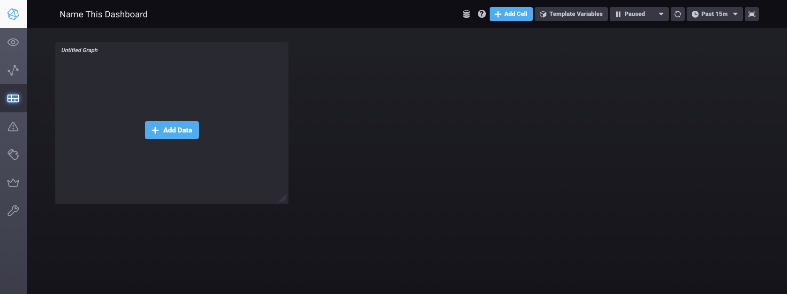
#4 Configure Chronograf Dashboard (3/4)
Add Cell & Data

Slide 22
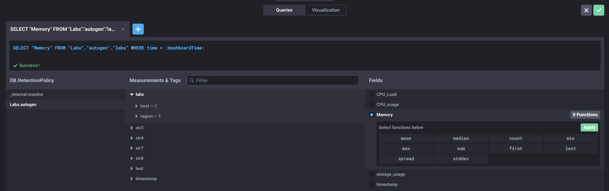
#4 Configure Chronograf Dashboard (4/4)
Add Data

Slide 23
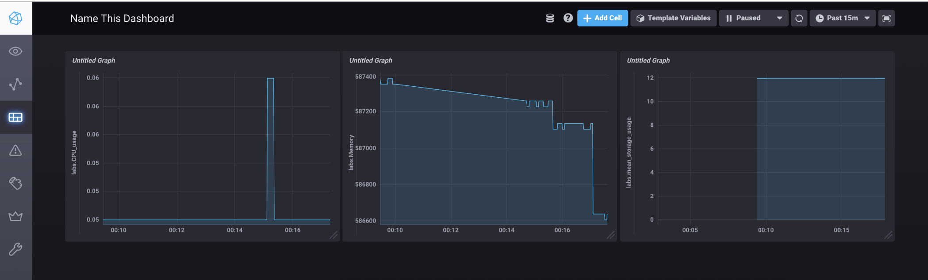
#5 – Check Chronograf Dashboard
We can see the changes of values from database

Slide 24
Note:
Remaining Lab practice requires
special Box resources with
IPMI or similar Remote Power Management,
PXE Boot support

Slide 25
Automated Provisioning & Visibility
Control Tower
Orchestration
Center
Provisioning
Center
Intelligence
Center
Visibility
Center
Docker Runtime
Linux Ubuntu OS

Slide 26
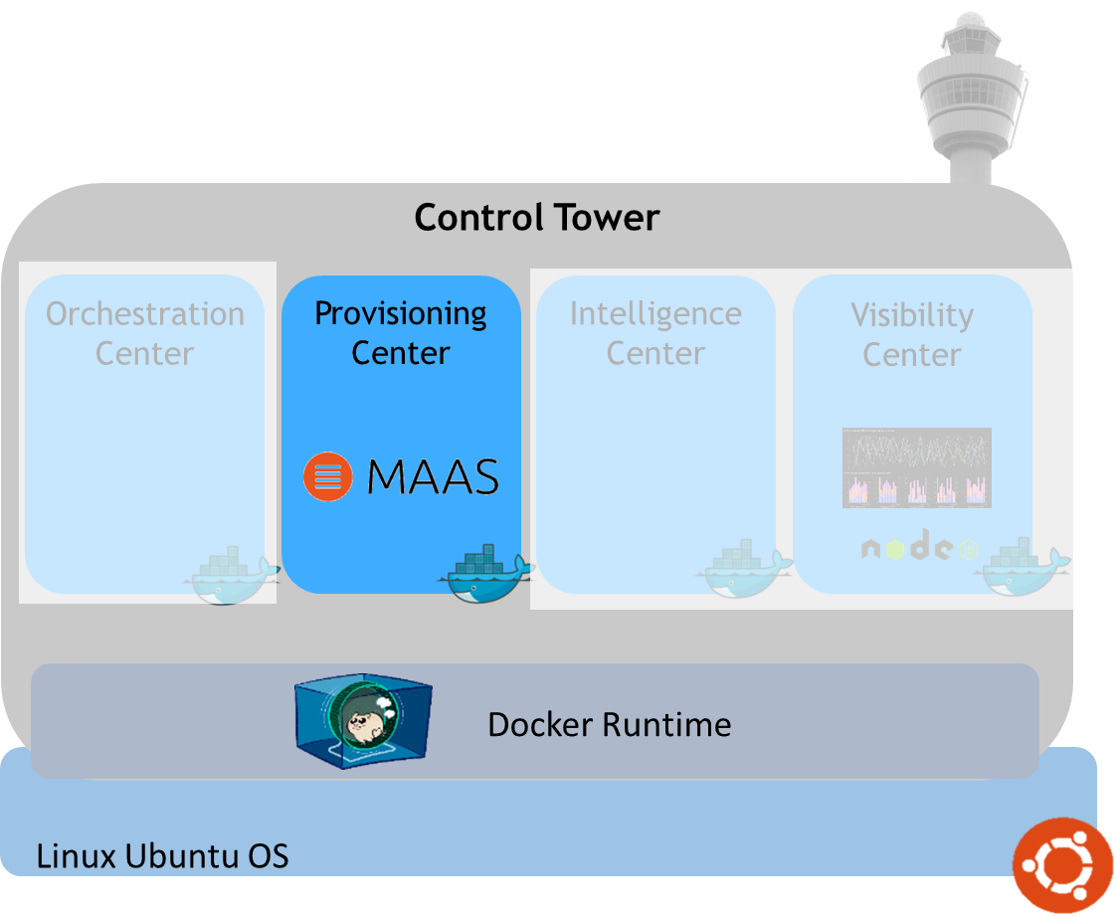
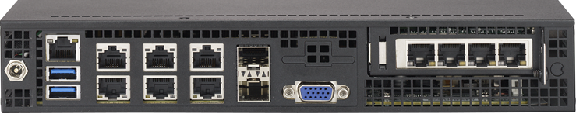
#6–1 OS Automated Installation: Establish physical interconnect
Power
Management & Control
IPMI port
Any Ethernet port
that support PXE
Requirements for Automated Installation
IPMI, Intel AMT, IBM HMC … and so on.
DHCP PXE bootable
Note: Typical NUC does not satisfy the above requirement!

Slide 27
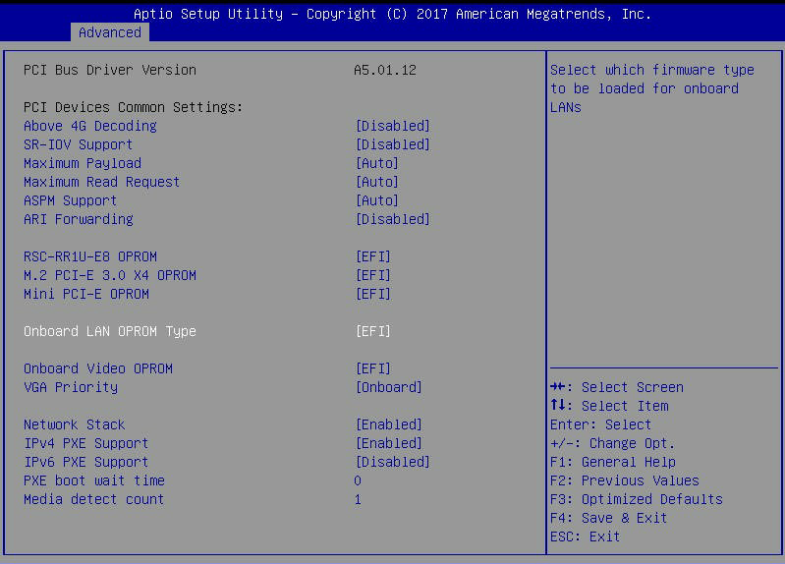
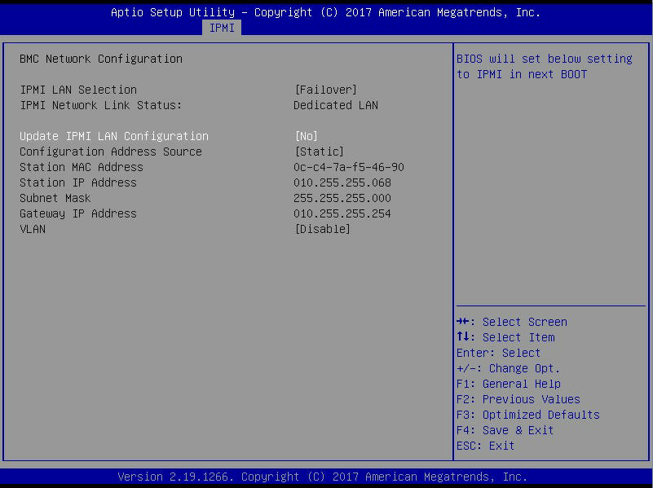
#6–2 OS Automatic Installation: BIOS Configuration
IPMI IP Configuration
<BIOS PXE Configuration>
<BIOS IPMI Configuration>
After then Save Configuration and Exit
And then the PXE booting sequence is stated

Slide 28
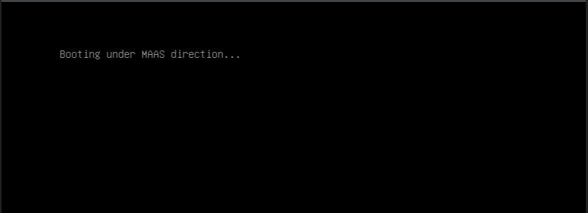
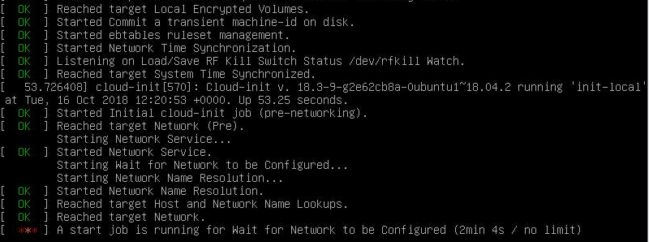
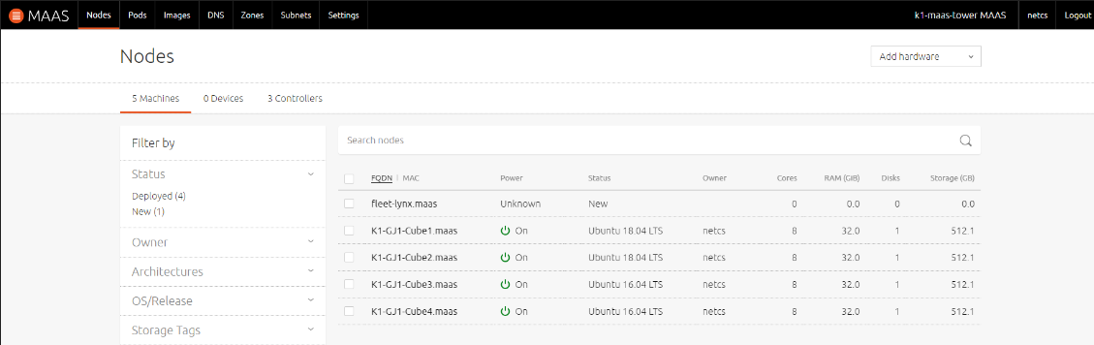
#7–1 OS Automatic Installation:
Enlistment
Check this message
<Succeed PXE booting>
<Enlistment after PXE booting>
<After Enlistment (you can check on Web GUI) >

Slide 29
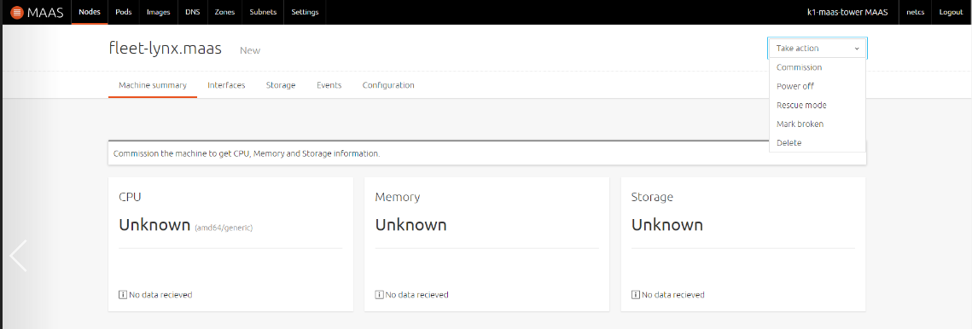
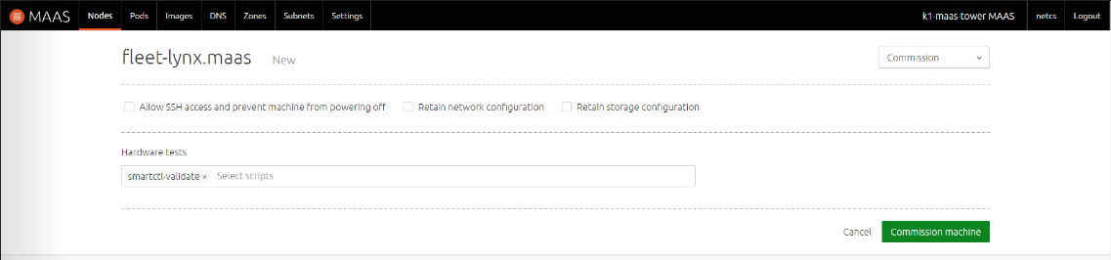
#7–2 OS Automatic Installation:
Commissioning
Click this button to commission
All the hardware information
shown as ‘Unknown’ before
Commissioning
Do not check anything
Click this button to commission
It takes about 10 minutes

Slide 30
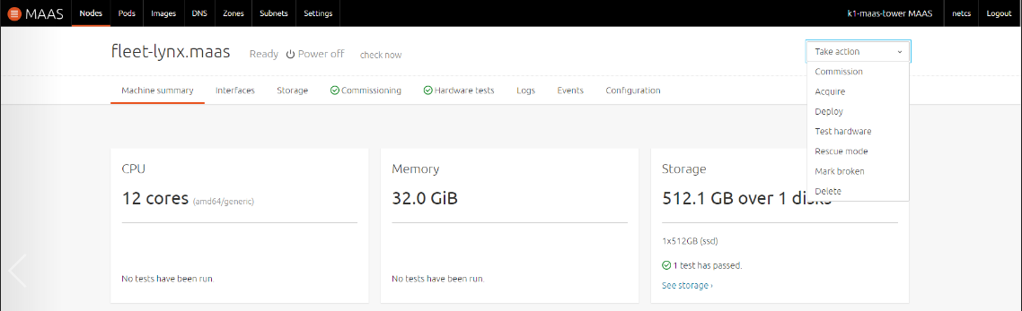
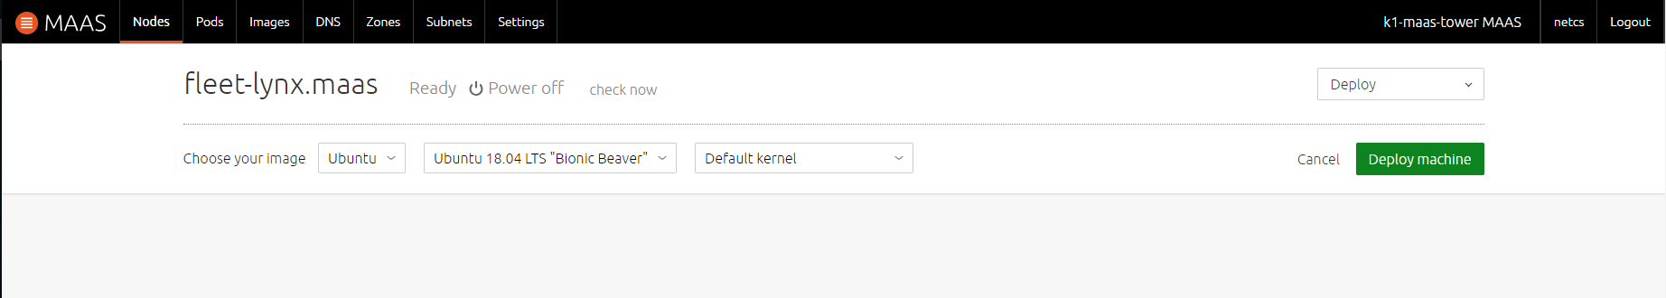
#7–3 OS Automatic Installation:
Deployment (1/2)
You can see Ready state
and power on/off state
after commissioning
Click this button to Deploy
You can see all the Hardware information
After commissioning
Click this button to Deploy
It is a OS Installation procedure
It takes about 15 minutes

Slide 31


#7–3 OS Automatic Installation:
Deployment (2/2)
<Complete Deploying (OS booted)>
Machine state is changed to
‘Deployed’
<Complete Deploying (On Web GUI)>

Slide 32
#8 Zabbix Server installation (1/2)
Add PPA (for Zabbix Server & Zabbix Agent)
$ wget https://repo.zabbix.com/zabbix/4.0/ubuntu/pool/main/z/zabbix-release/zabbix-release_4.0-2+xenial_all.deb
$ dpkg -i zabbix-release_4.0-2+xenial_all.deb
$ sudo apt-get update
Zabbix package installation
$ apt install zabbix-server-mysql zabbix-frontend-php zabbix-agent
Creating initial database
$ mysql –uroot –p<your root_password>
mysql> create database zabbix character set utf8 collate utf8_bin;
mysql> grant all privileges on zabbix.* to zabbix@localhost identified by ‘<your root_password>’;
mysql> quit;

Slide 33
#8 Zabbix Server installation (2/2)
Make new mysql user & password
$ zcat /usr/share/doc/zabbix-server-mysql*/create.sql.gz | mysql -uzabbix -p zabbix
Enter password: <Zabbix DB password>
Fix configuration file (add 4 lines)
$ sudo vi /etc/zabbix/zabbix_server.conf
DBHost=localhost
DBName=zabbix
DBUser=zabbix
DBPassword=<Zabbix DB password>

Slide 34
#9 Zabbix Service & Apache activation
Zabbix server service activation
$ sudo systemctl start zabbix-server
$ sudo systemctl enable zabbix-server
Apache activation
$ systemctl start apache2

Slide 35
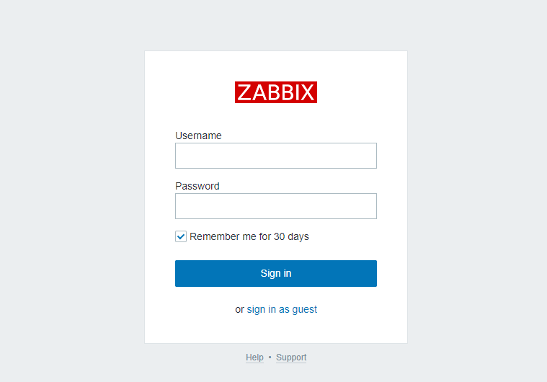
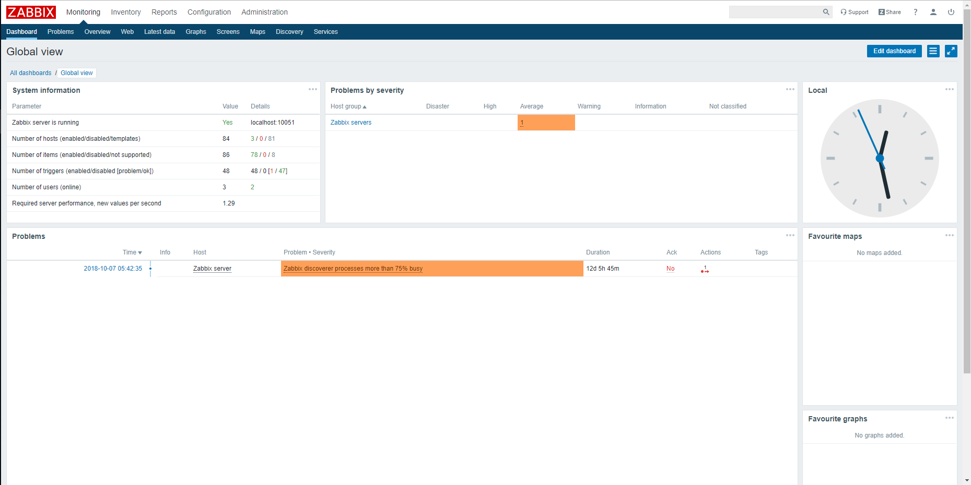
#10 Connect to Zabbix Web GUI
Connect to Web GUI (On the Web browser)
http://localhost/zabbix
Login via default Username / Password
Username: Admin
Password: zabbix
<Zabbix login page>
<Zabbix Web GUI>

Slide 36
#11–1 Zabbix Agent: Agent installation
Download and install Zabbix Agent
$ wget http://repo.zabbix.com/zabbix/2.4/debian/pool/main/z/zabbix/zabbix-agent_2.4.0-1+wheezy_amd64.deb
$ sudo dpkg -i zabbix-agent_2.4.0-1+wheezy_amd64.deb
Zabbix Agent configuration (Add 3 lines)
$ vi /etc/zabbix/zabbix_agentd.conf
Server=IP of Zabbix Server
ServerActive=IP of Zabbix Server
Hostname=use the FQDN of the node where the agent runs

Slide 37
#11–2 Zabbix Agent: Start Agent and open TCP port
Start Zabbix Agent service
$ systemctl restart zabbix-agent
Verify start daemon
$ sudo netstat –tulpn | grep zabbix
(if result is 10050/tcp, it is successfully worked)
Open TCP port using ufw tool
$ sudo apt-get install ufw
$ sudo ufw allow 10050/tcp

Slide 38
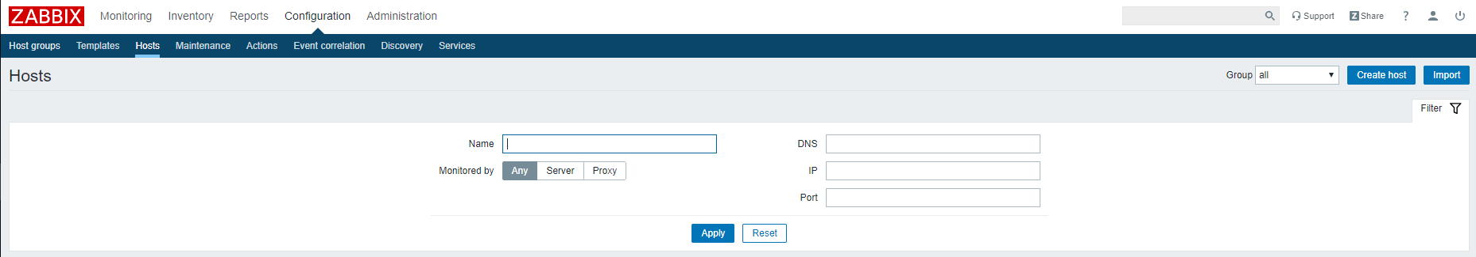
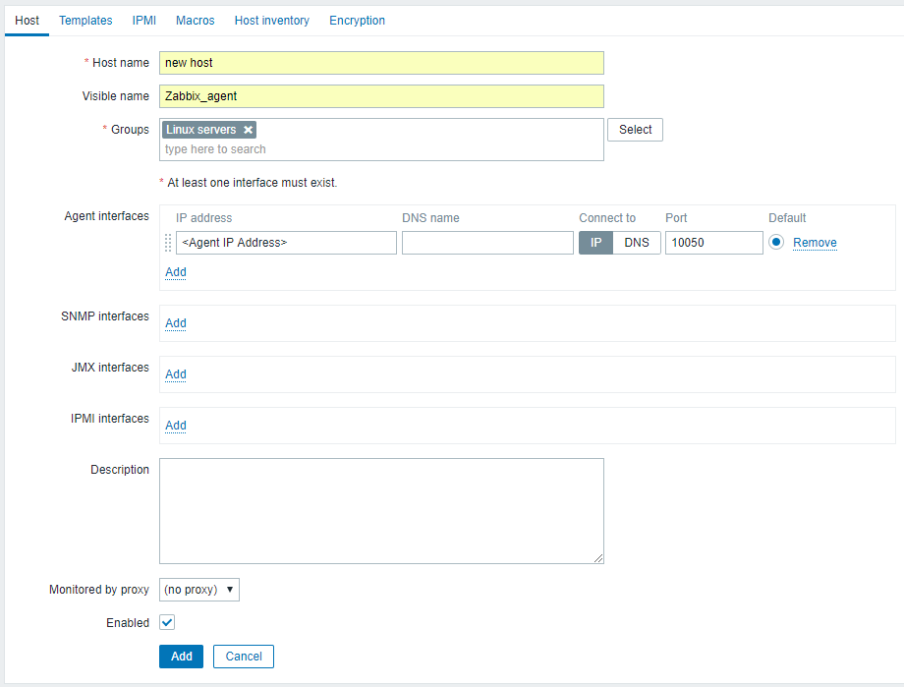
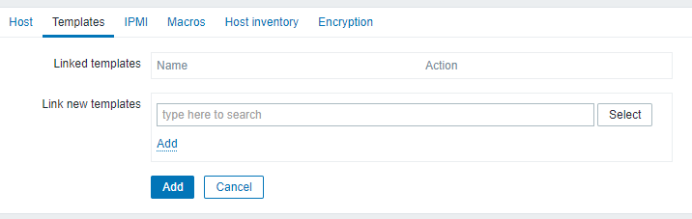
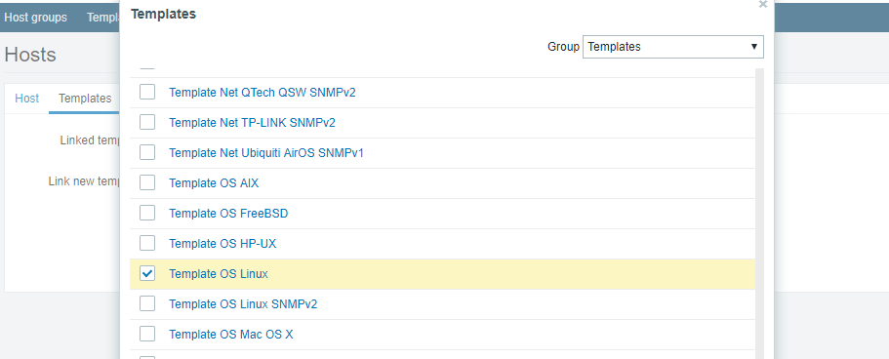
#12–1 Zabbix Monitoring: Add Zabbix monitored Host on Server
<Host Configuration menu on Web GUI>
<Host Configuration>
<Select Template>

Slide 39
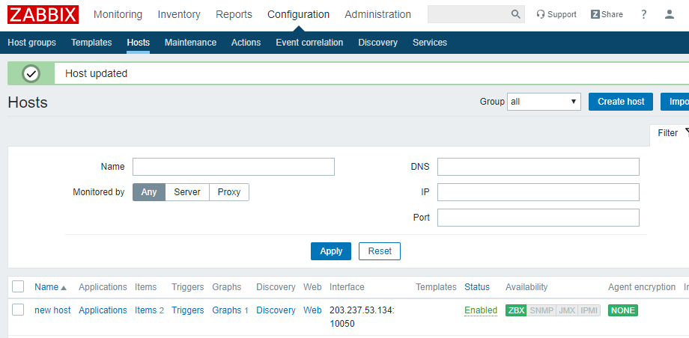
#12–2 Zabbix Monitoring: Adding host result & Add items
<Adding host result on Web GUI>

Slide 40
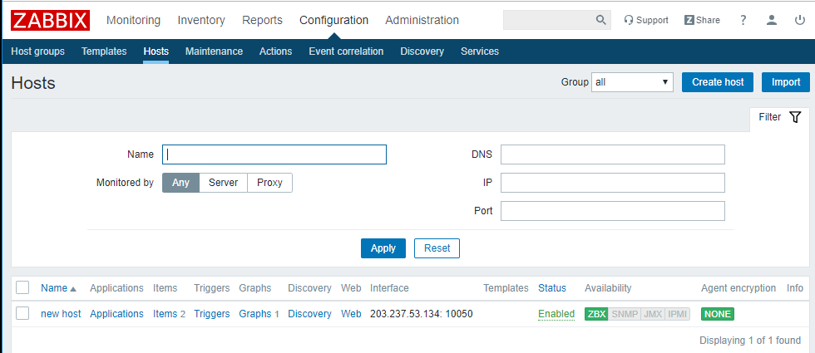
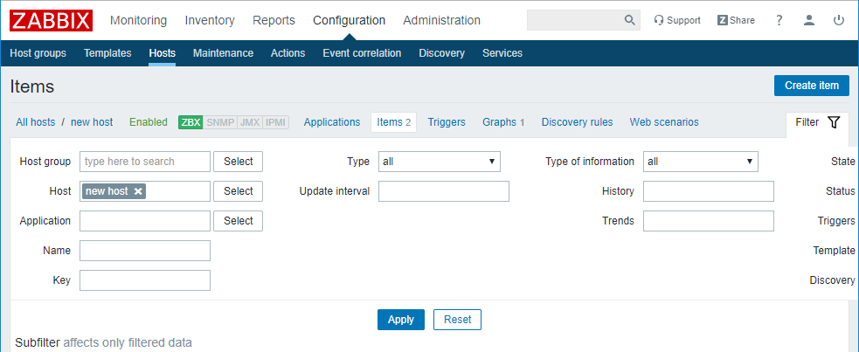
#12–3 Zabbix Monitoring:
Adding item to monitoring (1/2)

Slide 41
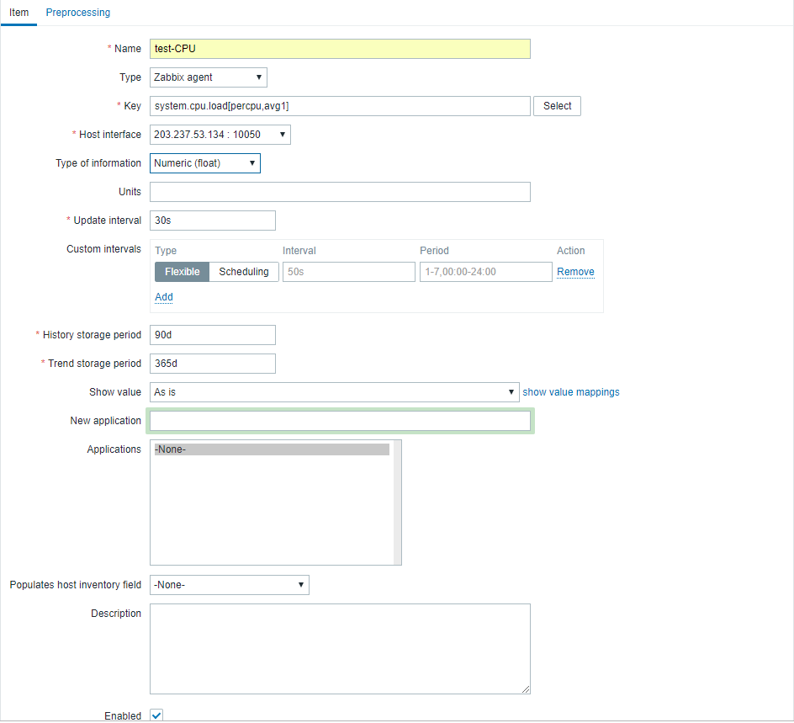
#12–3 Zabbix Monitoring:
Adding item to monitoring (2/2)
Configure three things
Click Add to add item

Slide 42
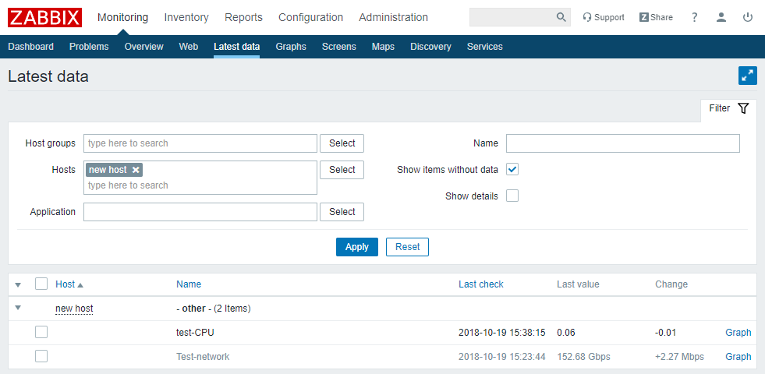
#12–4 Zabbix Monitoring: Adding Monitoring Graph
You must configure
filter and then click
apply
Click graph to show
graph

Slide 43

#12–5 Zabbix Monitoring: Result

Slide 44
Review

Slide 45
Lab Summary
With Tower Lab, you have experimented selected roles of Monitor/Control (관제) Tower
Visibility Center function to enable ‘distributed monitoring’ over remote Boxes and to store ‘monitoring information’ to time-size DB.
Provisioning Center function to enable remote ‘installation & configuration (of OS and others)’ of distributed Boxes.

Slide 46

Thank You for Your Attention
Any Questions?
mini@smartx.kr

